Slide 1
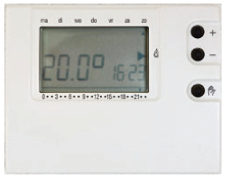
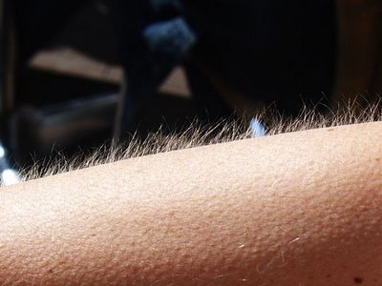
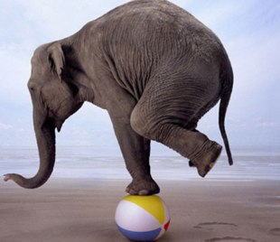
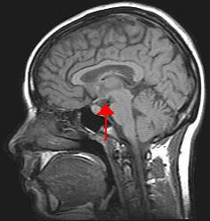
Homeostasis
Homeostasis
Homeostatic control systems have 3 parts:
  Sensor
  Integrator
  Effector
Negative Feedback
Positive Feedback
Examples including
  Thermoregulation, removing wastes/toxins

Slide 2
Try it – Balancing
  See how long you can balance with and without an external force working on you.

Slide 3
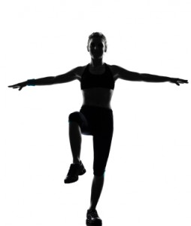
Warm-up
Stand up & balance on one foot.
Stay in this position until Ms. P tells you to switch or stop.
While you’re balancing, discuss with the person closest to you what you are feeling (physically) the longer you stand on one foot.

Slide 4

FEEDBACK
DISCUSS WITH YOUR NEIGHBOR…
What is feedback?
With what do you associate this term?
Based on the previous question, what would be considered normal or acceptable?
What happens if it’s not normal or acceptable?
What processes in the human body need to be kept with a particular range?

Slide 5

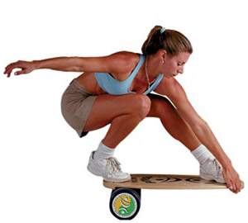
Homeostasis
The Body’s Attempt to Adjust to a Fluctuating External Environment

Slide 6
Homeostasis
The process by which a constant internal environment is maintained despite changes in the external environment.
Ex/ Hot or Cold, Exercise, Blood Loss, etc.
  What happens when you lose ¼ of your blood supply
Latin: homoios – similar/like
stasis – standing still

Slide 7
Examples of Homeostasis
Blood Glucose is kept at 0.1%
Temperature is kept at 37°C
Systolic Blood Pressure is kept at 120mmHg
Blood pH is kept at 7.35
These numbers do deviate slightly but too much and you cannot survive

Slide 8
Homeostasis
The body maintains a constant balance (steady state) through a series of monitored adjustments.
All homeostatic control systems have 3 parts:
  Sensor
  Integrator
  Effector

Slide 9
Homeostatic Control System
The Sensor: Special sensors determine the internal conditions
The Integrator: Takes the message sent by the sensor and compares the information to what it should be (set point). If necessary, it notifies the effector
The Effector: The Effector works to bring the system back to the set point.

Slide 10
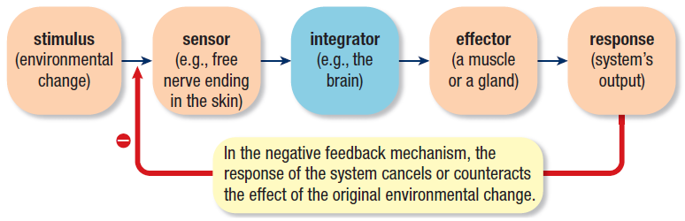

Slide 11
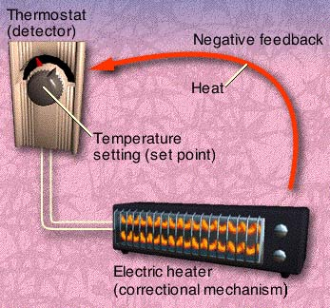
HOMEOSTASIS & FEEDBACK ANALOGY
The Home Heating System
When the temperature of a room decreases below a set point, the thermostat electrically starts the furnace.
As the temperature of the room rises to the set point, the thermostat shuts down the furnace.
As the room cools, step one is repeated.
There are three components to this system:
The Sensor which detects the stress.
The Control Center which receives information from the sensor and sends a message to the Effector.
The Effector which receives the message from the control center and produces the response which reestablishes homeostasis.

Slide 12
Negative Feedback
Mechanisms make adjustments to bring the body back to an accepted range.
Designed to resist further change.
    i.e. Too hot, body works to lower heat level.
Most feedback in the body is negative

Slide 13
CREATE NEGATIVE FEEDBACK FLOWCHARTS
Divide into 4 groups
Each group receives a different homeostatic system
  Group 1 – Hot thermoregulation
  Group 2 – cold thermoregulation
  Group 3 – blood pressure
  Group 4 – O2/co2 levels
Read description & identify:
  Stimulus
  Receptor
  Integrating/control center
  Effector
  Response
Organize into a cyclical flowchart
  See next slide for example

Slide 14
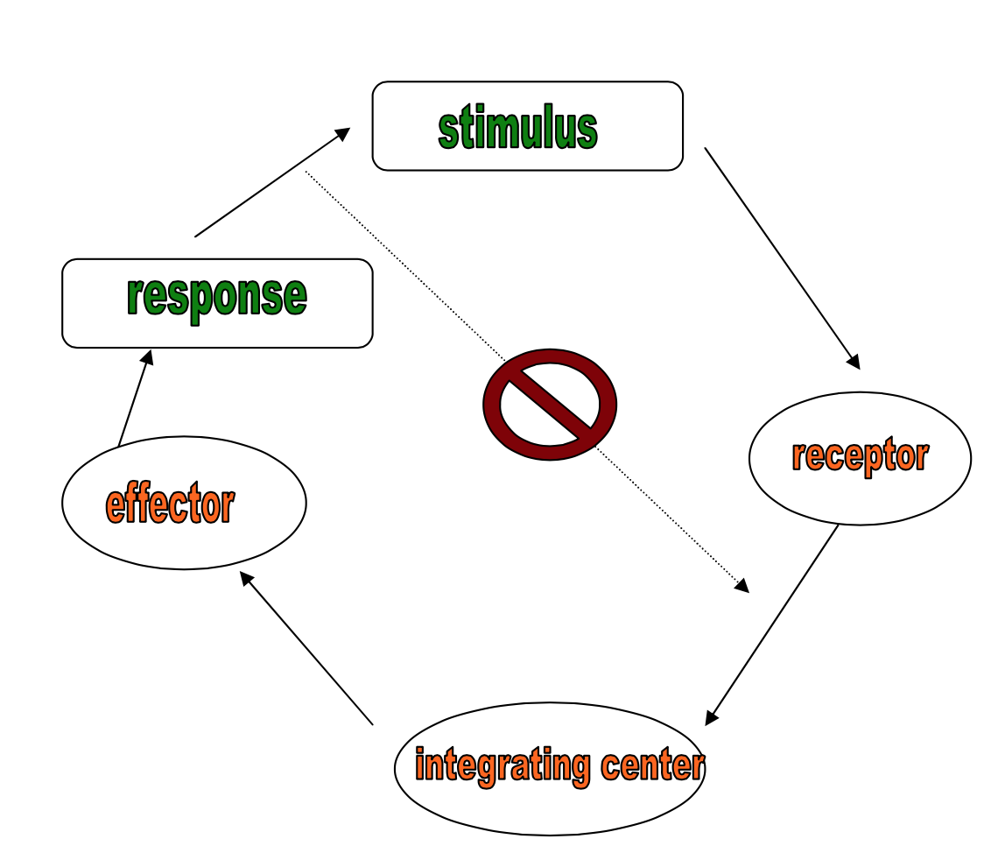
Cyclical flowchart

Slide 15
Exit ticket
On a post-it write something you learned about homeostasis today and cover your entry comment on the poster on the door.

Slide 16
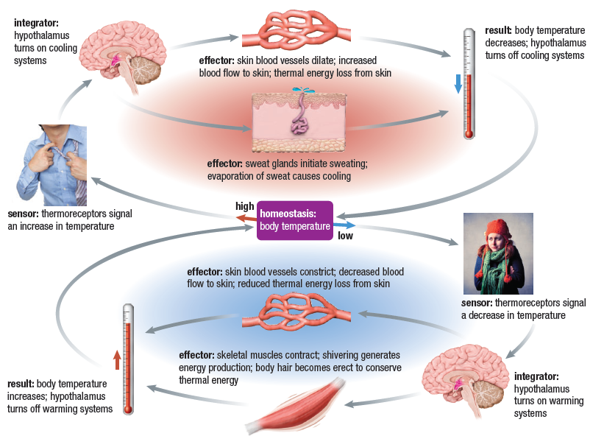

Slide 17
Positive Feedback
Mechanisms work to reinforce the change.
Variable moves even further away from a steady state.
Rarely found in the body
Advantage is that it allows a physiological event to occur quickly

Slide 18
Positive Feedback Mechanisms
Homeostatic systems utilizing positive feedback exhibit two primary characteristics:
Time limitation – Processes in the body that must be completed within a constrained time frame are usually modified by positive feedback.
Intensification of stress – During a positive feedback process, the initial imbalance or stress is intensified rather than reduced as it is in negative feedback.
Typical Positive Feedback Process
Stress
Sensor
Control Center
Intensifies
Effector

Slide 19
Examples
  Baby tries to escape uterus which causes the hormone (oxytocin) to be released → hormone causes the baby to be pushed out more (contractions) which causes the release of more hormones. This keeps occurring until the baby is out.
    You can’t naturally stop birth but you can induce it (make it happen) by providing oxytocin or a synthetic form (Pitocin) to the mother which begins the contractions.

Slide 20
Homeostatic Regulation of Child Birth through Positive Feedback
Nerve endings in the uterine wall carry afferent messages to the Hypothalamus
Pressure of Fetus on the Uterine Wall
Intensifies
Production and Release of Oxytocin into the Blood
Increasing strength of uterine contractions
The birth of the child will bring this process to a close. Other examples of positive feedback regulation occur during milk letdown and blood clotting.

Slide 21
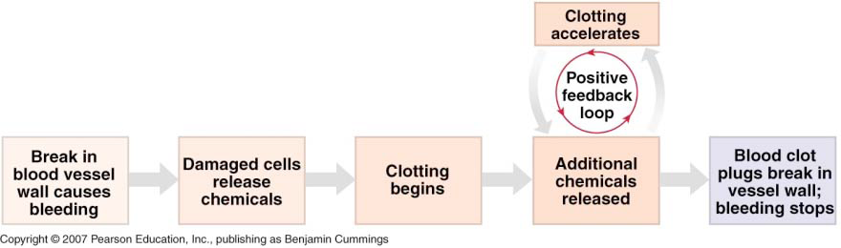
Feedback in Coagulation
Positive feedback “mini-loops” are built into pathway to speed up production of chemicals needed to form the clot. Entire sequence of clotting is a negative feedback pathway:

Slide 22
Harmful Effects of Positive Feedback
Positive feedback can be harmful. Two specific examples of these harmful outcomes would be:
Fever can cause a positive feedback within homeostasis that pushes the body temperature continually higher. If the temperature reaches 45 degrees centigrade (113 degrees Fahrenheit) cellular proteins denature bringing metabolism to a stop and death.
Chronic hypertension can favor the process of atherosclerosis which causes the openings of blood vessels to narrow. This, in turn, will intensify the hypertension bring on more damage to the walls of blood vessels.

Slide 23
Negative Feedback
Mechanisms make adjustments to bring the body back to an accepted range.
Designed to resist further change.
    i.e. Too hot, body works to lower heat level.
Most feedback in the body is negative

Slide 24
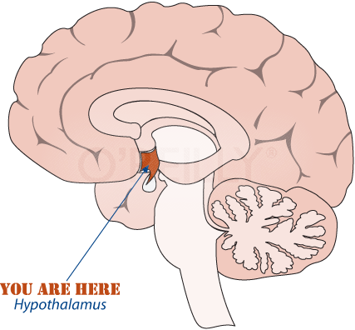
Thermoregulation
Maintaining body temperature (at a range where cell functions are efficient)
The hypothalamus is the co-ordinating centre for this homeostatic system.

Slide 25
Homeostatic Regulation of Body Temperature through Negative Feedback
Hyperthermia
Heat receptors in the skin
Hypothalamus
Stress
Sensors
Control Center
Stress is reduced shutting down mechanism
Increased activity of sweat glands
Perspiration evaporates cooling the skin
Increased blood flow to the skin
Effect
Effectors

Slide 26
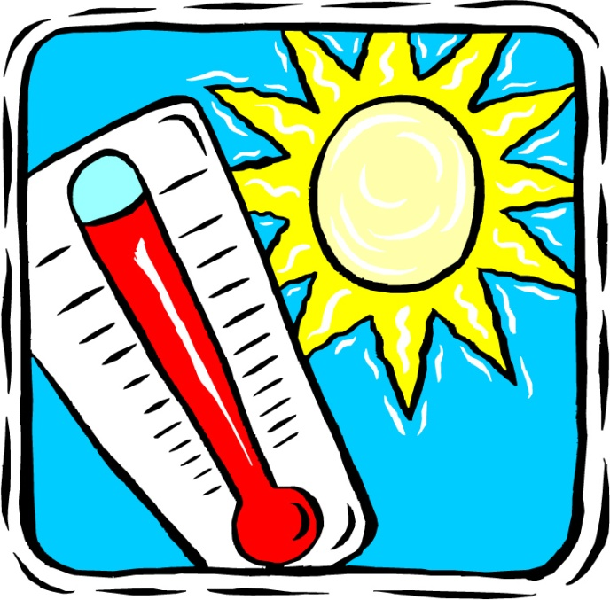
Too Hot??
Body works to get rid of extra heat:
  Blood vessels dilate
  Sweating
  Metabolism is slowed
Causes of Heat:
  Muscles working
  Digestion
  Hot environment

Slide 27
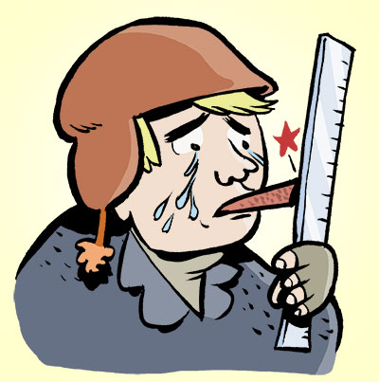
Too Cold??
Body works to create extra heat:
  Blood vessels constrict
  Shivering occurs
  Raised hairs (Goosebumps) – traps warm air
  Increase metabolic processes – creates heat (metabolic energy waste)
Causes of Cold:
  Cold Weather
  Swimming
  Sleeping

Slide 28
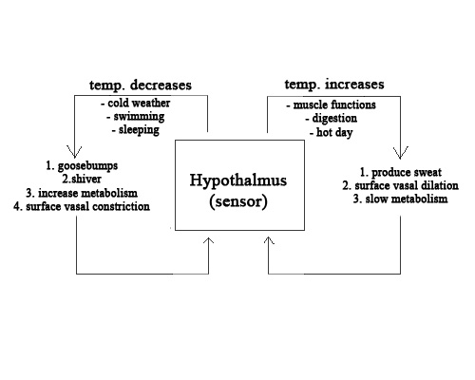

Slide 29
Homeostatic Regulation of Blood Sugar through Negative Feedback
Hyperglycemia
Pancreas-beta cells
Insulin is released
into blood
Stress
Sensor and Control center
Stress is reduced shutting down mechanism
Liver and Muscle cells take up glucose from the blood
Blood glucose is reduced
Effectors

Slide 30
Negative Feedback Via a Hormonal Pathway
Regulation of Blood Sugar
Hormones play an important role in many homeostatic pathways. Hormones are produced by endocrine glands. They enter the blood after being produced and travel throughout the body. However, hormones have their effect on specific target tissues.

Slide 31
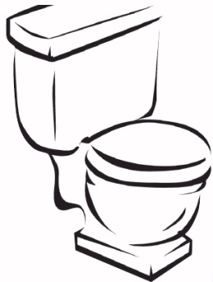
Excreting Wastes
Wastes are constantly being created in the body as we go about converting complex organic compounds into simpler ones.
Often waste products are toxic and must be converted into less toxic substances.
Wastes in the human body are stored until elimination is possible.

Slide 32
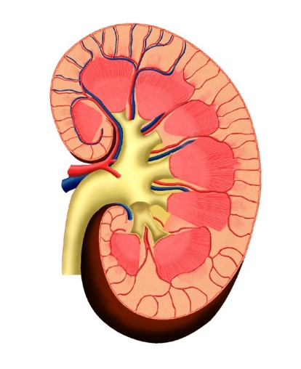
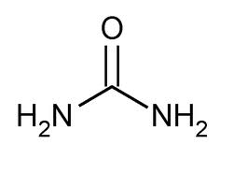
Ammonia – The Kidney
Ammonia(NH3) is created during protein catabolism through the deamination of amino acids
  Extremely toxic
2 NH3 combine with CO2 to form urea
  Much less toxic than NH3
(Uric acid - a by-product of nucleic acid catabolism is also excreted by the kidney)

Slide 33
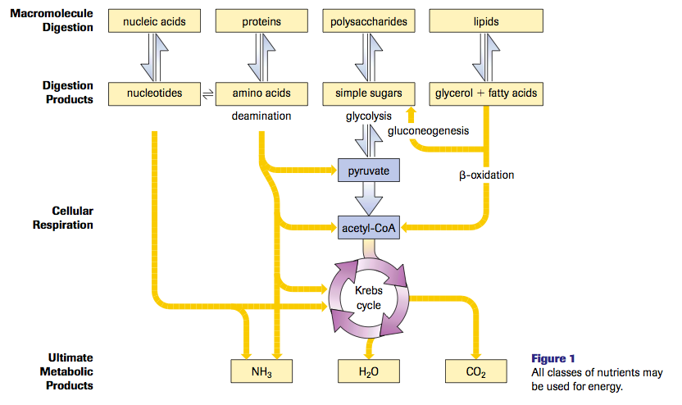

Slide 34
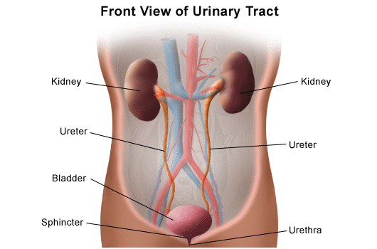
Solution – Higher Order Organisms
The Kidney/Urinary System

Slide 35
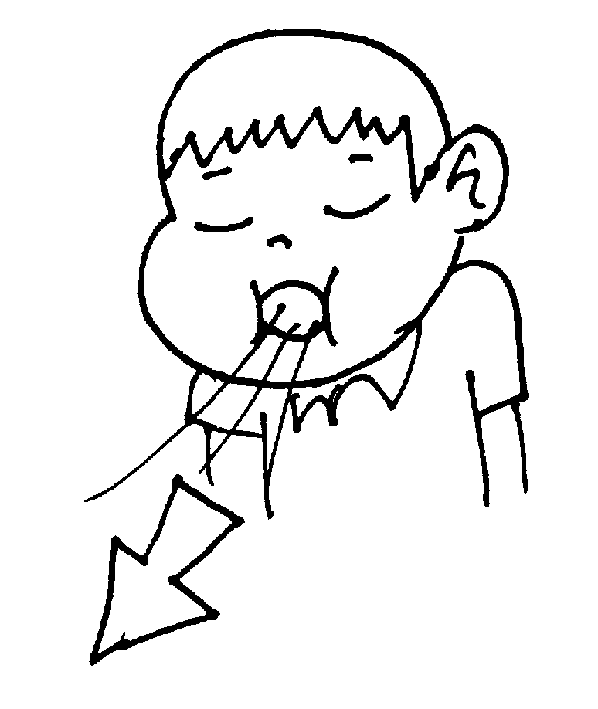
Carbon Dioxide – The Lungs
This waste product is formed during aerobic cellular respiration and is exhaled by the lungs.

Slide 36
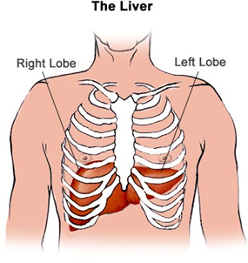
Lactic Acid – The Liver
A waste product from anaerobic respiration.

